Slide 1
secure data hiding in image using steganography
CAPSTONE PROJECT
Presented By: KAVIN SV
Student Name : KAVIN SV
College Name & Department : JAIN UNIVERSITY , Department of Information science & engineering (B tech ISE)

Slide 2
OUTLINE
Problem Statement
Technology used
Wow factor
End users
Result
Conclusion
Git-hub Link
Future scope

Slide 3
Problem Statement
This project develops an image-based steganography tool to securely hide secret messages within images using a passcode-based access system. The passcode is embedded within the image itself, ensuring that only authorized users can decrypt and retrieve the hidden data, providing a secure and self-contained method for confidential communication.

Slide 4
Technology used
This project implements a secure steganography technique by hiding secret messages within images using Python (IDLE). Libraries such as OpenCV (for image processing), NumPy (for data manipulation), os (for file operations), and string (for text handling) are utilized. The tool embeds both the message and passcode within the image, ensuring that only authorized users can decrypt and access the hidden data, offering a reliable and self-contained method for secure communication.

Slide 5
Wow factors
Some unique features that make your steganography project stand out from others:
Self-contained Encryption: The passcode is embedded directly into the image along with the message, eliminating the need for external password files and enhancing security.
Multi-library Integration: Efficient use of libraries like OpenCV, NumPy, and os for seamless image manipulation, data storage, and handling.
Password-based Access Control: Ensures that only users with the correct passcode can decrypt the hidden message, adding an extra layer of protection.
Lossless Data Preservation: Supports image formats that preserve data accurately, ensuring the hidden message remains intact.
Simple and Efficient Implementation: Lightweight, easy-to-use code that balances simplicity with strong data security, making it accessible even to beginners.

Slide 6
End users
The end users are:
Cybersecurity Professionals – For securely transmitting sensitive data without drawing attention.
Journalists and Activists – To protect confidential information and communications from surveillance or censorship.
Organizations and Businesses – For secure internal communication and safeguarding intellectual property.
Students and Researchers – As a learning tool for understanding steganography and data security concepts.
General Users – Anyone who needs to share sensitive information securely without using traditional encryption methods.
Government and Military Agencies – For secure communication of classified information, covert operations, and protecting national security data from cyber threats.

Slide 7
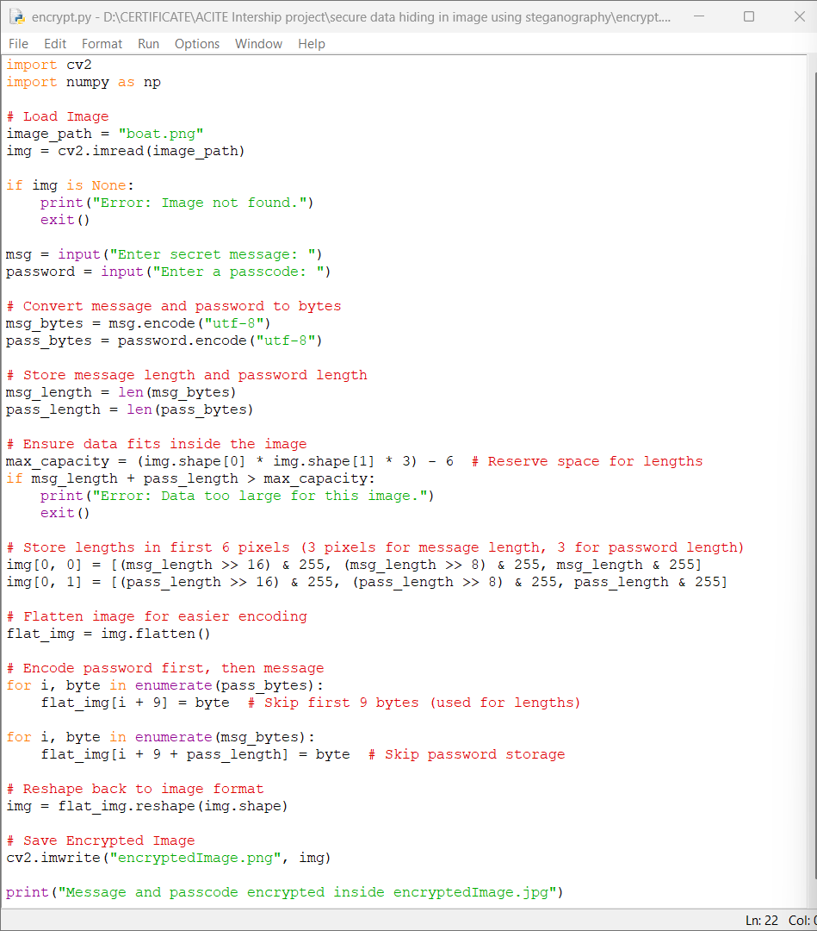
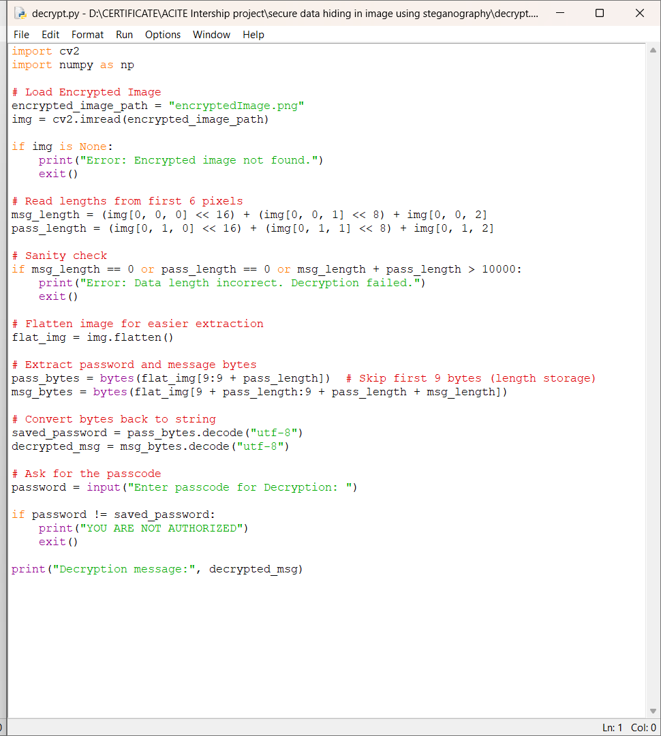
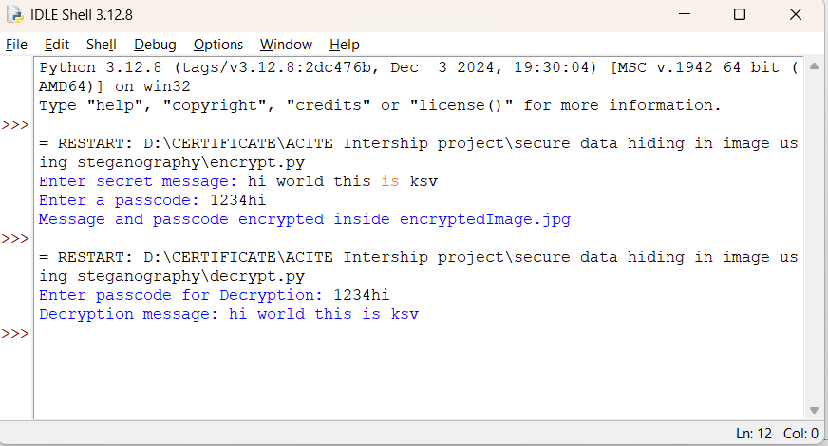
Results

Slide 8
Conclusion
In conclusion, this project successfully addresses the need for secure and undetectable communication by developing an image-based steganography tool using Python. By leveraging libraries like OpenCV, NumPy, os, and string, the tool efficiently embeds secret messages and passcodes directly into images, ensuring that only authorized users can access the hidden data. The self-contained encryption method enhances security without relying on external files, making it a reliable solution for protecting sensitive information in various fields such as cybersecurity, government, military, businesses, and personal communications. This project stands out for its simplicity, robustness, and versatility, providing a practical approach to modern data security challenges.

Slide 9
GitHub Link
https://github.com/KavinSV/secure-data-hiding-in-image-using-steganography.git

Slide 10
Future scope(optional)
Advanced Encryption Techniques: Integrate stronger encryption algorithms like AES to provide an additional layer of security before embedding the message.
Larger Data Capacity: Optimize the algorithm to hide larger messages without compromising image quality.
Error Detection and Correction: Implement techniques to detect and correct errors in case of image modifications during transmission.
Automation and Batch Processing: Enable encryption and decryption of multiple images simultaneously for faster and more efficient handling.
Cross-platform Application: Develop the tool as a cross-platform application for mobile and desktop use, enhancing accessibility for end users.
Steganalysis Resistance: Improve the algorithm to resist detection from steganalysis tools, making hidden data even more secure.

Slide 11
THANK YOU

